Slide 1

HUMAN RESOURCE MANAGEMENT
Global Edition 12e
Chapter 6
Employee Testing and Selection
Part 2 Recruitment and Placement
Copyright © 2011 Pearson Education
GARY DESSLER
PowerPoint Presentation by Charlie Cook
The University of West Alabama
Notes:
Human Resources Management 12e
Gary Dessler
Copyright © 2011 Pearson Education
1–<number>

Slide 2

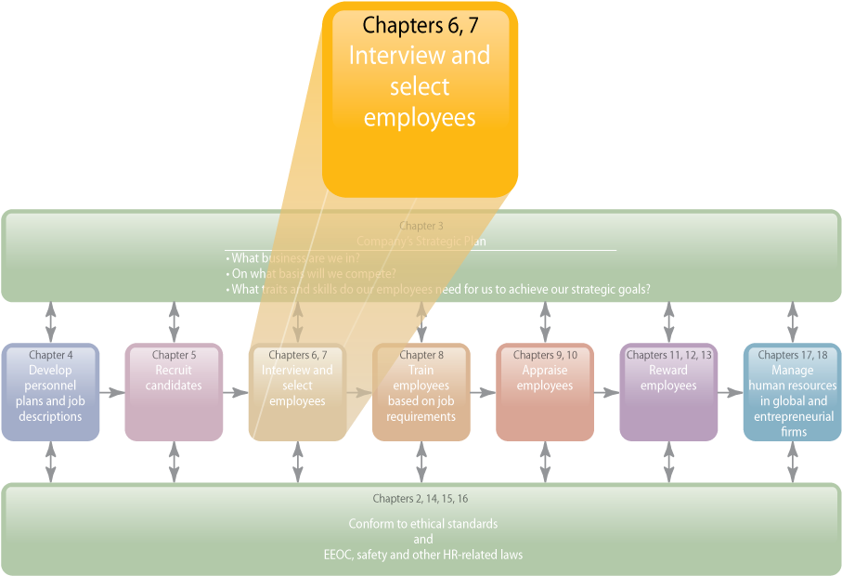
WHERE WE ARE NOW…
c
6–<number>
Notes:
Human Resources Management 12e
Gary Dessler
Copyright © 2011 Pearson Education
6–<number>
The purpose of Chapter 6 is to explain how to use various tools to select the best candidates for the job. The main topics covered include the selection process, basic testing techniques, background and reference checks, ethical and legal questions in testing, types of tests, and work samples and simulations.

Slide 3
LEARNING OUTCOMES
Explain what is meant by reliability and validity.
Explain how you would go about validating a test.
Cite and illustrate our testing guidelines.
Give examples of some of the ethical and legal considerations in testing.
List eight tests you could use for employee selection and how you would use them.
Give two examples of work sample/simulation tests.
Explain the key points to remember in conducting background investigations.
Copyright © 2011 Pearson Education
6–<number>
Notes:
Human Resources Management 12e
Gary Dessler
Copyright © 2011 Pearson Education
6–<number>

Slide 4
Why Careful Selection is Important
The Importance of Selecting the Right Employees
Organizational performance
Costs of recruiting and hiring
Legal obligations
and liability
Copyright © 2011 Pearson Education
6–<number>
Notes:
Human Resources Management 12e
Gary Dessler
Copyright © 2011 Pearson Education
6–<number>
Once you review your applicants’ résumés, the next step is selecting the best candidates for the job. This usually means whittling down the applicant pool by using the screening tools we cover in this chapter.
Nothing is more important than hiring the right employees. It is important for three main reasons: performance, costs, and legal obligations.

Slide 5
Avoiding Negligent Hiring Claims
Carefully scrutinize information on employment applications.
Get written authorization for reference checks, and check references.
Save all records and information about the applicant.
Reject applicants for false statements or conviction records for offenses related to the job.
Balance the applicant’s privacy rights with others’ “need to know.”
Take immediate disciplinary action if problems arise.
Copyright © 2011 Pearson Education
6–<number>
Notes:
Human Resources Management 12e
Gary Dessler
Copyright © 2011 Pearson Education
6–<number>
Avoiding negligent hiring claims means taking “reasonable steps” to avoid hiring employees with criminal records or other problems who commit crimes or other acts for which the employer can be held liable.

Slide 6
Basic Testing Concepts
Reliability
  Describes the consistency of scores obtained by the same person when retested with the identical or alternate forms of the same test.
  Are test results stable over time?
Validity
  Indicates whether a test is measuring what it is supposed to be measuring.
  Does the test actually measure what it is intended to measure?
Copyright © 2011 Pearson Education
6–<number>
Notes:
Human Resources Management 12e
Gary Dessler
Copyright © 2011 Pearson Education
6–<number>
A test is, basically, a sample of a person’s behavior. Using a test (or any selection tool) assumes the tool is both reliable and valid. Few things illustrate evidence-based HR—the deliberate use of the best-available evidence in making decisions about the human resource management practices you are focusing on—as do checking for reliability and validity.

Slide 7

FIGURE 6–1 A Slide from the Rorschach Test
Copyright © 2011 Pearson Education
6–<number>
Notes:
Human Resources Management 12e
Gary Dessler
Copyright © 2011 Pearson Education
6–<number>
In the Rorschach Test sample in Figure 6-1, the psychologist asks the person to explain how he or she interprets an ambiguous picture. In such projective tests, it is more difficult to prove that the tests are measuring what they are said to measure, in this case, some trait of the person’s personality—that they’re valid.

Slide 8
Types of Validity
Types of
Test Validity
Criterion validity
Content validity
Copyright © 2011 Pearson Education
6–<number>
Notes:
Human Resources Management 12e
Gary Dessler
Copyright © 2011 Pearson Education
6–<number>
In employment testing, there are two main ways to demonstrate a test’s validity: criterion validity and content validity.
Criterion validity means demonstrating that those who do well on the test also do well on the job, and that those who do poorly on the test do poorly on the job. In psychological measurement, a predictor is the measurement (in this case, the test score) that you are trying to relate to a criterion, such as performance on the job.
Employers demonstrate the content validity of a test by showing that the test constitutes a fair sample of the job’s content. The basic procedure here is to identify job tasks that are critical to performance, and then randomly select a sample of those tasks to test.

Slide 9
Evidence-Based HR: How to Validate a Test
Steps in Test Validation
1
Analyze the Job: predictors and criteria
2
Choose the Tests: test battery or single test
3
Administer the Test: concurrent or predictive validation
4
Relate Your Test Scores and Criteria: scores versus actual performance
5
Cross-Validate and Revalidate: repeat Steps 3 and 4 with a different sample
Copyright © 2011 Pearson Education
6–<number>
Notes:
Human Resources Management 12e
Gary Dessler
Copyright © 2011 Pearson Education
6–<number>
Anyone using tests (or test results) should know something about validation. The validation process consists of the five steps listed in the slide.

Slide 10
FIGURE 6–2 Examples of Web Sites Offering Information on Tests or Testing Programs
www.hr-guide.com/data/G371.htm
Provides general information and sources
for all types of employment tests
http://ericae.net
Provides technical information on all types
of employment and nonemployment
tests.www.ets.org/testcoll
Provides information on over 20,000 tests
www.kaplan.com
Information from Kaplan test preparation
on how various admissions tests work
www.assessments.biz
One of many firms offering employment tests
Copyright © 2011 Pearson Education
6–<number>
Notes:
Human Resources Management 12e
Gary Dessler
Copyright © 2011 Pearson Education
6–<number>
Figure 6-2 presents several Web sites that provide information about tests or testing programs.

Slide 11
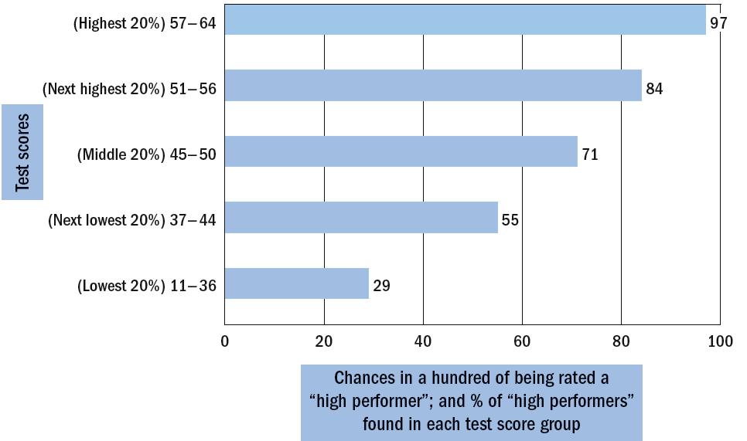
FIGURE 6–3 Expectancy Chart
Note: This expectancy chart shows the relation between scores made on the Minnesota Paper Form Board and rated success of junior draftspersons.
Example: Those who score between 37 and 44 have a 55% chance of being rated above average and those scoring between 57 and 64 have a 97% chance.
Copyright © 2011 Pearson Education
6–<number>
Notes:
Human Resources Management 12e
Gary Dessler
Copyright © 2011 Pearson Education
6–<number>
If there is a correlation between test and job performance, you can develop an expectancy chart that presents the relationship between test scores and job performance graphically. The expectancy chart in Figure 6-3 shows the percentage of high job performers in each of five test score groups.

Slide 12

TABLE 6–1 Testing Program Guidelines
Use tests as supplements.
Validate the tests.
Monitor your testing/selection program.
Keep accurate records.
Use a certified psychologist.
Manage test conditions.
Revalidate periodically.
Copyright © 2011 Pearson Education
6–<number>
Notes:
Human Resources Management 12e
Gary Dessler
Copyright © 2011 Pearson Education
6–<number>
Table 6-1 summarizes important testing guidelines, such as “use tests as supplements.”

Slide 13
Test Takers’ Individual Rights and Test Security
Under the APA’s standard for educational and psychological tests, test takers have the following rights:
  The right to the confidentiality of test results.
  The right to informed consent regarding use of these results.
  The right to expect that only people qualified to interpret the scores will have access to them, or that sufficient information will accompany the scores to ensure their appropriate interpretation.
  The right to expect the test is fair to all. For example, no one taking it should have prior access to the questions or answers.
Copyright © 2011 Pearson Education
6–<number>
Notes:
Human Resources Management 12e
Gary Dessler
Copyright © 2011 Pearson Education
6–<number>
Test takers have rights to privacy and feedback under the American Psychological Association’s (APA) standard for educational and psychological tests; these guide psychologists but are not legally enforceable.

Slide 14
Legal Privacy Issues
Defamation
  Libeling or slandering of employees or former employees by an employer.
Avoiding Employee Defamation Suits
  Train supervisors regarding the importance of employee confidentiality.
  Adopt a “need to know” policy.
  Disclose procedures impacting confidentially of information to employees.
Copyright © 2011 Pearson Education
6–<number>
Notes:
Human Resources Management 12e
Gary Dessler
Copyright © 2011 Pearson Education
6–<number>
Common law also provides some protection against disclosing information about employees to people outside the company. The main application here involves defamation (either libel or slander), but there are privacy issues, too.

Slide 15
How Do Employers Use Tests at Work?
Major Types of Tests
  Basic skills tests
  Job skills tests
  Psychological tests
Why Use Testing?
  Increased work demands = more testing
  Screen out bad or dishonest employees
  Reduce turnover by personality profiling
Copyright © 2011 Pearson Education
6–<number>
Notes:
Human Resources Management 12e
Gary Dessler
Copyright © 2011 Pearson Education
6–<number>
Firms test applicants for basic skills (defined as the ability to read instructions, write reports, and do arithmetic adequate to perform common workplace tasks). Many others require employees to take job skills tests and require some form of psychological measurement. Employers don’t use tests just to find good employees, but also to screen out bad ones.

Slide 16
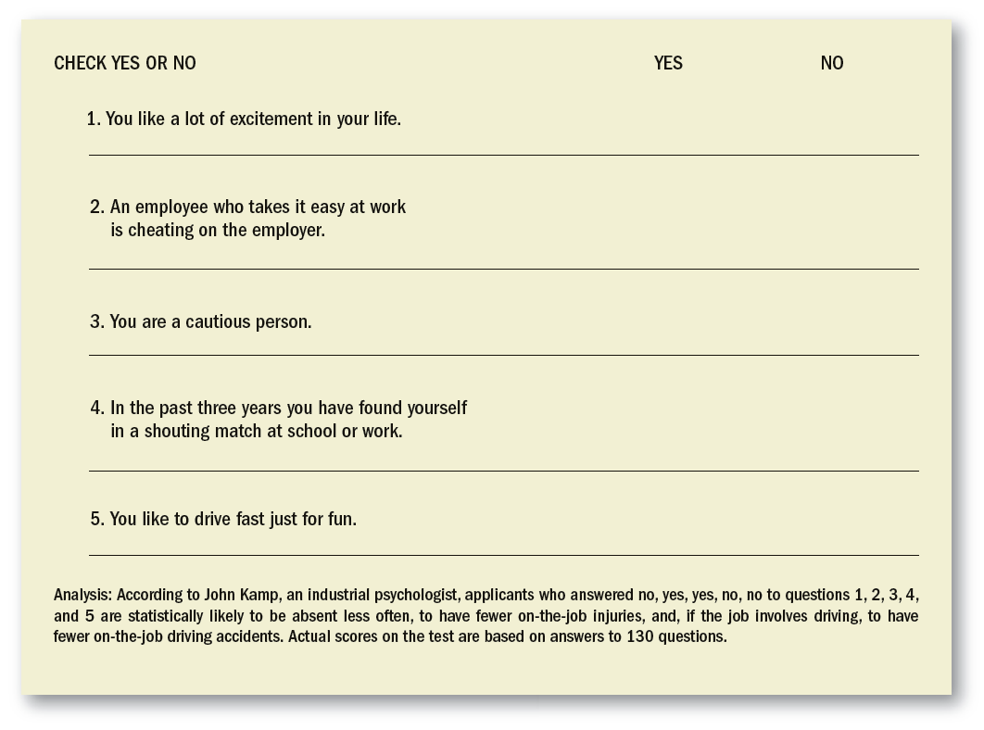
FIGURE 6–4 Sample Test
Copyright © 2011 Pearson Education
6–<number>
Notes:
Human Resources Management 12e
Gary Dessler
Copyright © 2011 Pearson Education
6–<number>
The short test in Figure 6-4 is intended to find out how prone you might be to on-the-job accidents.

Slide 17
Computerized and Online Testing
Online tests
  Telephone prescreening
  Offline computer tests
  Virtual “inbox” tests
  Online problem-solving tests
Types of Tests
  Specialized work sample tests
  Numerical ability tests
  Reading comprehension tests
  Clerical comparing and checking tests
Copyright © 2011 Pearson Education
6–<number>
Notes:
Human Resources Management 12e
Gary Dessler
Copyright © 2011 Pearson Education
6–<number>
Computerized and/or online testing is increasingly replacing conventional paper-and-pencil and manual tests. Many firms have applicants take online or offline computerized tests—sometimes by phone, using the touch-tone keypad, sometimes online—to prescreen applicants quickly prior to more in-depth interviews and background checks.

Slide 18
Types of Tests
What Different Tests Measure
Cognitive abilities
Motor and physical abilities
Personality
and interests
Current
achievement
Copyright © 2011 Pearson Education
6–<number>
Notes:
Human Resources Management 12e
Gary Dessler
Copyright © 2011 Pearson Education
6–<number>
Cognitive tests include tests of general reasoning ability (intelligence) and tests of specific mental abilities like memory and inductive reasoning.
Tests of motor and physical abilities measure motor abilities, such as finger dexterity, manual dexterity, and reaction time.
Personality tests measure basic aspects of an applicant’s personality, such as introversion, stability, and motivation.
Achievement tests measure what someone has learned. Most of the tests you take in school are achievement tests. They measure your “job knowledge” in areas like economics, marketing, or human resources.

Slide 19
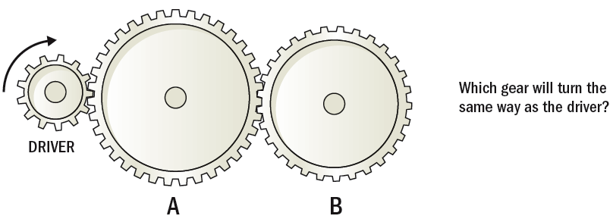
FIGURE 6–5 Type of Question Applicant Might Expect on a Test of Mechanical Comprehension
Copyright © 2011 Pearson Education
6–<number>
Notes:
Human Resources Management 12e
Gary Dessler
Copyright © 2011 Pearson Education
6–<number>
The Test of Mechanical Comprehension in Figure 6-5 tests applicants’ understanding of basic mechanical principles.

Slide 20
The “Big Five”
Extraversion
Conscientiousness
Emotional stability/ Neuroticism
Agreeableness
Openness to experience
Copyright © 2011 Pearson Education
6–<number>
Notes:
Human Resources Management 12e
Gary Dessler
Copyright © 2011 Pearson Education
6–<number>
Industrial psychologists often focus on the “big five” personality dimensions: extraversion, emotional stability/neuroticism, agreeableness, conscientiousness, and openness to experience.

Slide 21
Work Samples and Simulations
Measuring Work Performance Directly
Work
samples
Management assessment centers
Video-based situational testing
Miniature job training and evaluation
Copyright © 2011 Pearson Education
6–<number>
Notes:
Human Resources Management 12e
Gary Dessler
Copyright © 2011 Pearson Education
6–<number>
With work samples, examinees are presented with situations representative of the job for which they’re applying, and are evaluated on their responses.
Experts consider these (and simulations, like the assessment centers we also discuss in this section) to be tests. However, they differ from most test forms, because they measure job performance directly.

Slide 22
FIGURE 6–7 Example of a Work Sampling Question
Checks key before installing against:
___ shaft score 3
___ pulley score 2
___ neither score 1
Note: This is one step in installing pulleys and belts.
Copyright © 2011 Pearson Education
6–<number>
Notes:
Human Resources Management 12e
Gary Dessler
Copyright © 2011 Pearson Education
6–<number>
Figure 6-7 shows one of the steps required for installing pulleys and belts—“checks key before installing.” As the figure shows, possible approaches here include checking the key against (1) the shaft, (2) the pulley, or (3) neither. The right of the figure lists the weights (scores) reflecting the worth of each method. The applicant performs the task, and the observer checks off the approach used.

Slide 23
TABLE 6–2 Evaluation of Assessment Methods on Four Key Criteria
Assessment Method | Validity | Adverse Impact | Costs (Develop/ Administer) | Applicant Reactions
Cognitive ability tests | High | High (against minorities) | Low/low | Somewhat favorable
Job knowledge test | High | High (against minorities) | Low/low | More favorable
Personality tests | Low to moderate | Low | Low/low | Less favorable
Biographical data inventories | Moderate | Low to high for different types | High/low | Less favorable
Integrity tests | Moderate to high | Low | Low/low | Less favorable
Structured interviews | High | Low | High/high | More favorable
Physical fitness tests | Moderate to high | High (against females and older workers) | High/high | More favorable
Situational judgment tests | Moderate | Moderate (against minorities) | High/low | More favorable
Work samples | High | Low | High/high | More favorable
Assessment centers | Moderate to high | Low to moderate, depending on exercise | High/high | More favorable
Physical ability tests | Moderate to high | High (against females and older workers) | High/high | More favorable
Note: There was limited research evidence available on applicant reactions to situational judgment tests and physical ability tests. However, because these tests tend to appear very relevant to the job, it is likely that applicant reactions to them would be favorable.
Copyright © 2011 Pearson Education
6–<number>
Notes:
Human Resources Management 12e
Gary Dessler
Copyright © 2011 Pearson Education
6–<number>
Table 6-2 summarizes the validity, cost, and potential adverse impact of several popular assessment methods.

Slide 24
Background Investigations and
Other Selection Methods
Investigations and Checks
  Reference checks
  Background employment checks
  Criminal records
  Driving records
  Credit checks
Why?
  To verify factual information provided by applicants
  To uncover damaging information
Copyright © 2011 Pearson Education
6–<number>
Notes:
Human Resources Management 12e
Gary Dessler
Copyright © 2011 Pearson Education
6–<number>
To avoid negligent hiring mistakes, employers must check the candidate’s background thoroughly.

Slide 25
Background Investigations and Reference Checks
Former Employers
Current Supervisors
Sources of
Information
Commercial Credit
Rating Companies
Written References
Social Networking Sites
Copyright © 2011 Pearson Education
6–<number>
Notes:
Human Resources Management 12e
Gary Dessler
Copyright © 2011 Pearson Education
6–<number>
Most employers check and verify the job applicant’s background information and references. Commonly verified data include legal eligibility for employment (in compliance with immigration laws), dates of prior employment, military service (including discharge status), education, identification (including date of birth and address to confirm identity), county criminal records (current residence, last residence), motor vehicle record, credit, licensing verification, Social Security number, and reference check.

Slide 26
Limitations on Background Investigations and Reference Checks
Legal Issues: Defamation
Background Investigations and
Reference Checks
Employer Guidelines
Legal Issues: Privacy
Supervisor Reluctance
Copyright © 2011 Pearson Education
6–<number>
Notes:
Human Resources Management 12e
Gary Dessler
Copyright © 2011 Pearson Education
6–<number>
In practice (as most people instinctively know), giving someone a bad reference can drag you into a legal mess.
A communication is defamatory if it is false and tends to harm the reputation of another by lowering the person in the estimation of the community or by deterring other persons from associating or dealing with him or her.
Employees can sue employers for disclosing true but embarrassing private facts about the employee.
In practice, many firms have a policy of not providing any information about former employees except for their dates of employment, last salary, and position titles.
To avoid potential invasion of privacy issues, employers should obtain the applicant’s written permission before checking into the applicant’s background information, even if that information is publicly available (e.g., published on social networking sites).

Slide 27
Making Background Checks More Useful
Include on the application form a statement for applicants to sign explicitly authorizing a background check.
Use telephone references if possible.
Be persistent in obtaining information.
Compare the submitted résumé to the application.
Ask open-ended questions to elicit more information from references.
Use references provided by the candidate as a source for other references.
Copyright © 2011 Pearson Education
6–<number>
Notes:
Human Resources Management 12e
Gary Dessler
Copyright © 2011 Pearson Education
6–<number>
To obtain better information on an applicant’s background, employers can follow these guidelines.

Slide 28
Using Preemployment Information Services
Acquisition and Use of Background Information
1
Disclosure to and authorization by applicant/employee
2
Employer certification to reporting agency
3
Providing copies of reports to applicant/employee
4
Notice of adverse action to applicant/employee
Copyright © 2011 Pearson Education
6–<number>
Notes:
Human Resources Management 12e
Gary Dessler
Copyright © 2011 Pearson Education
6–<number>
Various federal and state laws govern how employers acquire and use applicants’ and employees’ background information. The Fair Credit Reporting Act is the main directive. Compliance with these laws essentially involves these four steps.

Slide 29
The Polygraph and Honesty Testing
Employee Polygraph Protection Act of 1988
  Generally prohibits polygraph examinations by all private employers unless:
    The employer has suffered an economic loss or injury.
    The employee in question had access to the property.
    There is a reasonable prior suspicion.
    The employee is told the details of the investigation, as well as questions to be asked on the polygraph test itself.
  Private business exceptions:
    Private security employees
    Employees with access to drugs
    Ongoing economic loss or injury investigations
Copyright © 2011 Pearson Education
6–<number>
Notes:
Human Resources Management 12e
Gary Dessler
Copyright © 2011 Pearson Education
6–<number>
Employee Polygraph Protection Act of 1988. This law severely restricts the polygraph (or lie detector) and other mechanical or electrical devices that attempt to measure honesty or dishonesty for honesty testing. Federal laws don’t prohibit paper-and-pencil tests and chemical testing (as for drugs).

Slide 30
Honesty Testing Programs:
What Employers Can Do
Antitheft Screening Procedure:
  Ask blunt questions.
  Listen, rather than talk.
  Do a credit check.
  Check all employment and personal references.
  Use paper-and-pencil honesty tests and psychological tests.
  Test for drugs.
  Establish a search-and-seizure policy and conduct searches.
Copyright © 2011 Pearson Education
6–<number>
Notes:
Human Resources Management 12e
Gary Dessler
Copyright © 2011 Pearson Education
6–<number>
With or without testing, there’s a lot a manager or employer can do to screen out dishonest applicants or employees. Honesty testing still requires some caution. Having “failed” an “honesty test,” the candidate may feel his or her treatment was less than proper. Some “honesty” questions also pose invasion-of-privacy issues.

Slide 31
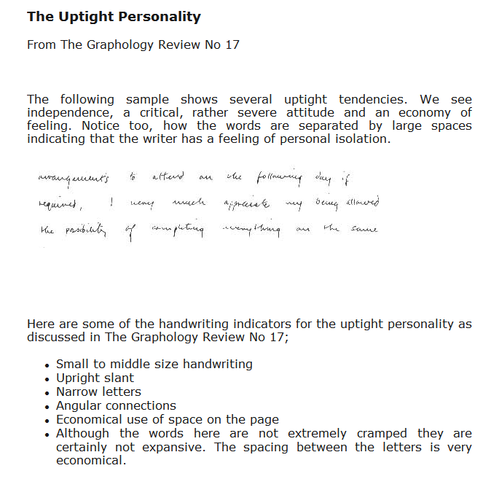
FIGURE 6–9 “The Uptight Personality”
Copyright © 2011 Pearson Education
6–<number>
Notes:
Human Resources Management 12e
Gary Dessler
Copyright © 2011 Pearson Education
6–<number>
Graphology refers to the use of handwriting analysis to determine the writer’s basic personality traits. Graphology has some resemblance to projective personality tests, although graphology’s validity is highly suspect.
According to a graphologist, the writing in Figure 6-9 exemplifies traits such as “independence” and “isolation.”

Slide 32
Physical Examinations
Reasons for preemployment medical examinations:
  To verify that the applicant meets the physical requirements of the position.
  To discover any medical limitations to be taken into account in placing the applicant.
  To establish a record and baseline of the applicant’s health for future insurance or compensation claims.
  To reduce absenteeism and accidents.
  To detect communicable diseases that may be unknown to the applicant.
Copyright © 2011 Pearson Education
6–<number>
Notes:
Human Resources Management 12e
Gary Dessler
Copyright © 2011 Pearson Education
6–<number>
Once the employer extends the person a job offer, a medical exam is often the next step in the selection (although it may also occur after the new employee starts work).
The Americans with Disabilities Act permits a medical exam during the period between the job offer and commencement of work if such exams are standard practice for all applicants for that job category.

Slide 33
Substance Abuse Screening
Types of Screening
  Before formal hiring
  After a work accident
  Presence of obvious behavioral symptoms
  Random or periodic basis
  Transfer or promotion to new position
Types of Tests
  Urinalysis
  Hair follicle testing
Copyright © 2011 Pearson Education
6–<number>
Notes:
Human Resources Management 12e
Gary Dessler
Copyright © 2011 Pearson Education
6–<number>
Many employers conduct drug screenings to test candidates before hire, to test current employees after specific work incidents or on a random or periodic basis, while others require drug tests when they transfer or promote employees to new positions.
Substance tests have become increasingly more accurate in detecting a broader spectrum of substances over longer periods of past use.

Slide 34
Substance Abuse Screening Issues
Safety:
impairment vs. presence
American with Disabilities Act
Recreational use vs. addiction
Ethical and Legal Issues
Drug Free Workplace Act of 1998
Intrusiveness of testing procedures
Accuracy of tests
Copyright © 2011 Pearson Education
6–<number>
Notes:
Human Resources Management 12e
Gary Dessler
Copyright © 2011 Pearson Education
6–<number>
Many factors impact on the detection of employee substance abuse and the subsequent actions that employers can, should, or must take.

Slide 35
FIGURE 6–10 Procedure in Complying with Immigration Law
Hire only citizens and aliens lawfully authorized to work in the United States.
Advise all new job applicants of your policy.
Require all new employees to complete and sign the verification form (the “I-9 form”) designated by the Immigration and Naturalization Service (INS) to certify that they are eligible for employment.
Examine documentation presented by all new employees, record information about the documents on the verification form, and sign the form.
Retain the form for three years or for one year past the employment of the individual, whichever is longer.
If requested, present the form for inspection by INS or Department of Labor officers. No reporting is required.
Copyright © 2011 Pearson Education
6–<number>
Notes:
Human Resources Management 12e
Gary Dessler
Copyright © 2011 Pearson Education
6–<number>
To comply with this law, Figure 6-10 outlines the steps employers should follow in completing the I-9 Employment Eligibility Verification form and complying with federal immigration laws.
Employers can avoid accusations of discrimination by verifying the documents of all applicants, not just those they may think suspicious.

Slide 36
Improving Productivity Through HRIS:
Using Automated Applicant Tracking and Screening Systems (ATS)
Benefits of Applicant Tracking Systems
“Knock out” applicants who
do not meet job requirements
Allows employers to extensively test and screen applicants online
Can match “hidden talents” of applicants to available openings
Copyright © 2011 Pearson Education
6–<number>
Notes:
Human Resources Management 12e
Gary Dessler
Copyright © 2011 Pearson Education
6–<number>
The applicant tracking systems do more than compile incoming Web-based résumés and track applicants during the hiring process. They should also help with the testing and screening.

Slide 37
FIGURE 6–11 Checklist: What to Look For in an Applicant Tracking System (ATS)
The employer thinking of adopting an ATS should seek one that meets several minimum functionality requirements. Among other things, the ATS should be:
Easy to use.
Capable of being integrated into the company’s existing HRIS platform, so that, for instance, data on a newly hired candidate can flow seamlessly into the HRIS payroll system.
Able to capture, track, and report applicant EEO data.
Able to provide employee selection performance metrics reports, including “time to fill,” “cost to hire,” and “applicant source statistics.”
Able to facilitate scheduling and tracking of candidate interviews, email communications, and completed forms, including job offers.
Able to provide automated screening and ranking of candidates based upon job skill profiles.
Able to provide an internal job posting service that supports applications from current employees and employee referral programs.
Able to cross-post jobs to commercial job boards such as www.monster.com.
Able to integrate the ATS job board with your company’s own Web site; for instance, by linking it to your site’s “careers” section.
Able to provide for requisition creation and signoff approvals.
Copyright © 2011 Pearson Education
6–<number>
Notes:
Human Resources Management 12e
Gary Dessler
Copyright © 2011 Pearson Education
6–<number>
Figure 6-11 lists what the effective ATS should do.

Slide 38
K E Y T E R M S
reliability
test validity
criterion validity
content validity
expectancy chart
interest inventory
work samples
work sampling technique
management assessment center
situational test
video-based simulation
miniature job training and evaluation
Copyright © 2011 Pearson Education
6–<number>
Notes:
Human Resources Management 12e
Gary Dessler
Copyright © 2011 Pearson Education
6–<number>

Slide 39

All rights reserved. No part of this publication may be reproduced, stored in a retrieval system, or transmitted, in any form or by any means, electronic, mechanical, photocopying, recording, or otherwise, without the prior written permission of the publisher. Printed in the United States of America.
Copyright © 2011 Pearson Education
6–<number>
Notes:
Human Resources Management 12e
Gary Dessler
Copyright © 2011 Pearson Education
6–<number>

